Slide 1
CZ3006/CE3005
Part I - Tutorial 1

Slide 2
Answer to Q1: Comparison between OSI and TCP/IP Models
The OSI model has 7 layers.
The TCP/IP model has 5 layers.
The upper three layers in the OSI model is combined as the application layer in the TCP/IP model.
The OSI model is a conceptual model in theory.
The TCP/IP model is implemented in practice.

Slide 3
Additional Comments to Q1
(not Required in the Answer):
OSI 7-Layer Model
Layer | Name | Function
7 | Application | Allows applications to request network services.
6 | Presentation | Converts data so that systems that use different data formats can exchange information.
5 | Session | Establishes sessions between network applications.
4 | Transport | Provides for reliable delivery of packets.
3 | Network | Handles routing of data across network segments.
2 | Data Link | Provides MAC addresses to uniquely identify network nodes and a means for data to be sent over the Physical layer in the form of packets. Bridges and switches are layer 2 devices.
1 | Physical | Governs the layout of cables (media) and devices such as repeaters and hubs.

Slide 4
Additional Comments to Q1
(not Required in the Answer): Internet TCP/IP Model
Layer | Name | Function
5 | Application | Acts as final endpoints at either end of a communication session between two network hosts
4 | Transport | Manages the flow of traffic between two hosts or devices, ensuring that data arrives at the application on the host for which it is targeted
3 | Internet (Network) | Contains all functionality that manages the movement of data between two network devices over a routed network
2 | Link and Media Access | Deals with the network connectivity among neighboring devices.
1 | Physical | Handles physical media and devices

Slide 5
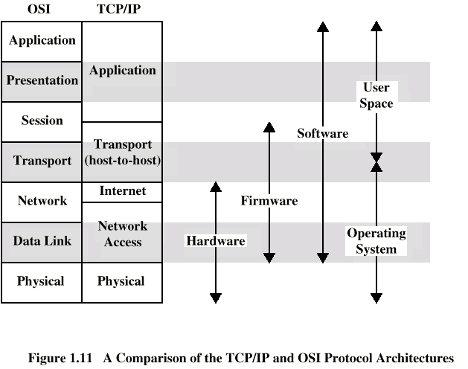
Additional Comments to Q1
(not Required in the Answer):
Comparison between OSI and TCP/IP Models

Slide 6
Answer to Q2:
Header Processing in a Network
At the sender, as the message moves down the OSI layers, each layer adds a header to it.
By default, a switching node has only three layers: network, data link, and physical layers since a switching node does not need to have higher layers to process the message (e.g., a switching node just needs to forward the message without knowing the meaningful content). Hence, at a switching node, the message first travels up the layers and then travels down the layers. When the message travels up the layers, headers are stripped by the layers. When the message travels down the layers, headers are added by the layers.

Slide 7

Additional Illustrations to Q2
(not Required in the Answer):
Header Processing in a Network
A
Packet Switched
Network
B
1
Packet Switched
Network
3
2
Sending
Process
Receiving
Process
Application
Application
Presentation
Presentation
Session
Session
Transport
Transport
Network
Network
Network
Network
Network
Data Link
Data Link
Data Link
Data Link
Data Link
Physical
Physical
Physical
Physical
Physical
Node 1
Node 2
Node 3
Notes:
Slide 13

Slide 8
Sending
Process
Additional Illustrations to Q2
(not Required in the Answer):
Header Processing at the Sender
Data
Application layer
Presentation layer
Session layer
Transport layer
Network layer
Data link layer
Physical Layer
Application layer header
AH
Data
Presentation
layer header
PH
Data
Session
layer header
SH
Data
Transport
layer header
TH
Data
Network
layer header
NH
Data
Data link
layer trailer:
for error
correction
Data link
layer header
DH
Data
T
bits

Slide 9
Additional Illustrations to Q2
(not Required in the Answer):
Header Processing at the Switching Nodes
Sending
Process
Application
Presentation
Session
Transport
Network
Data link
Physical
NH
NH
Network
NH
Data Link
Node 2
DH
T
DH
T
DH
T
Bits
Bits
Physical
Bits
Node 1

Slide 10
Q3: 6-9’s Reliability
In network resilience, the link failure probability can be interpreted as the percentage of the time that the link goes down during a time window. In a carrier-grade network, it is often required that the network should have 6 9’s (i.e, 99.9999%) reliability. Please calculate the duration of allowable downtime per year for this network?

Slide 11
Q3: 6-9’s Reliability
In this case, reliability r = 99.9999%
Failure probability b=1-r = 10⁻⁶
  The notation b means “broken”.
  Failure probability means the probability that the link is broken; i.e., the percentage of link downtime.
Assume a regular year (365 days)
The allowable downtime per year is
T = 365D × 24H/D × 60M/H × 60 S/M × 10⁻⁶
= 31.5 seconds

Slide 12
Q4: Network Resilience
Singapore (SG) is connected to San Francisco (SF), via an intermediate node at Hawaii (HW). Two independent links connect between Singapore and Hawaii, and a long-range link connects between Singapore and San Francisco. Assume that each link fails independently with probability of 0.05. Calculate the probability in which SG is disconnected from SF.
SG
HW
SF

Slide 13
Q4: Network Resilience
SG
HW
SF
Step 1: Calculate the resilience between SG and HW
b_{SG-HW} = Pr[both upper and lower links fail]
= 0.05 × 0.05 = 0.0025
Step 2: Calculate the resilience between SG and SF thru indirect link
r_{SG-HW-SF} = Pr[both SG-HW and HW-SF survive]
= (1-0.0025) × (1-0.05) = 0.947625
Note that we use b and r to denote the “broken” and “reliable” probability, respectively.

Slide 14
Q4: Network Resilience
SG
HW
SF
Step 3: Calculate the failure between SG and SF thru indirect link
b_{SG-HW-SF} = 1- r_{SG-HW-SF} =1- 0.947625 = 0.052375
Step 4: Calculate the failure between SG and SF
b_{SG-SF} = Pr[both direct and indirect paths fail]
= 0.05 × 0.052375 = 0.00261875
Note that we use b and r to denote the “broken” and “reliable” probability, respectively.

